Slide 1
Voice Controlled Music Player
B11901150 易靖杰 B11901173 陳顗帆

Slide 2
Table of contents
01
02
03
04
Main Ideas
Data Flow
Preliminary
Experiments
Possible Problems

Slide 3
Main ideas
Press a button to record user commands
Recognize the recording
Manipulate a speaker to play trending music online

Slide 4
STM-32 – Edge processing IOT node
High Level Overview:
Data Acquisition: Microphone + DMA to record speaker
Data Proccessing: preprocess data for CNN model on Rpi
Data Transmition: Send preprocessed data to Rpi

Slide 5
RPI – Internet Access and Playback speaker
High Level Overview:
Act as wifi server
Access Internet to find playlists (automatically updates along with current times)
Light CNN model to process data sent by STM32
Play songs through speaker

Slide 6
Data Flow on STM32
User Button Callback -> Task record -> Microphone_sample -> Buffer (through DMA)
Buffer_filled_callback -> Task Preprocess -> arm_FIR_filter
# If possible
Load data through quantized model to identify target
# Else
Preproccessing algorithm
Task_wifi -> connects to rpi -> send data

Slide 7
Data Flow on RPI
Wifi socket -> connect to STM32
receive data -> apply CNN model -> obtain keywords
switch (keyword)
case (pop) …
case (rock) …
case (play) …
case (next) …
case (...)

Slide 8
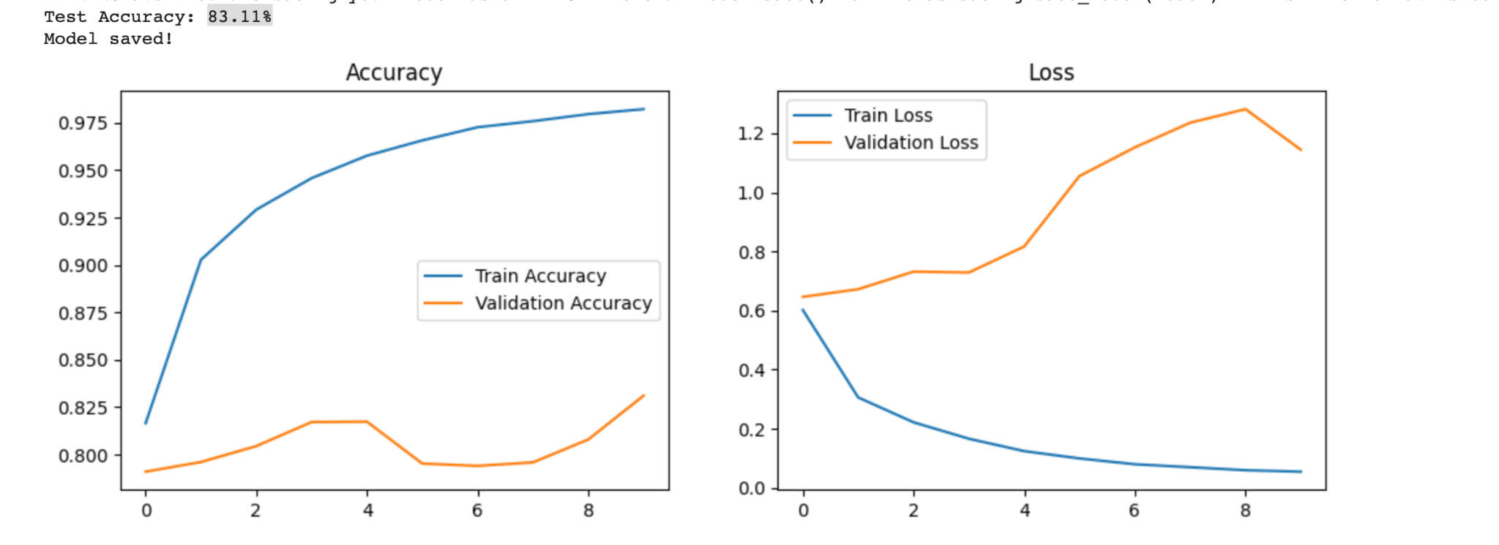
Preliminary Experiment 1 - CNN
Trained a network on Google’s Keyword and loaded it on Rpi

Slide 9
Preliminary Experiment 2 - Playback
Python code to achieve audio download and playback on PC:
Given a url we can find and download the music from youtube and play it on the PC

Slide 10
Possible Problems - Dataset
Hard to find required spoken keyword dataset on the internet:
eg. Play, Pause, Next, Back, POP, ROCK
Consider self recording? Might Overfit.
Ask our friends?

Slide 11
Possible Problems - Model Size
Current Model Size is 6.27 MB
After Quantization Accuracy is 10%
Can not implement on STM, can only be used on RPI.

Slide 12
Possible Problems - Preproccesing
Need to convert data gathered from STM as CNN model format.
Need STFT and to compute MEL Spectrogram.
Computationally difficult for STM, might need to decrease sampling rate and shorten keywords

